Slide 1



B
Al-Bashir Hotel
By : group 22

Slide 2

IN
El-Bashir Hotel

Slide 3





Customer
Employee
Exit

Slide 4







Ahmed Ashraf
Al-Bashir Hotel
B
Home
Booking
Bill
Information
Sign in
return

Slide 5
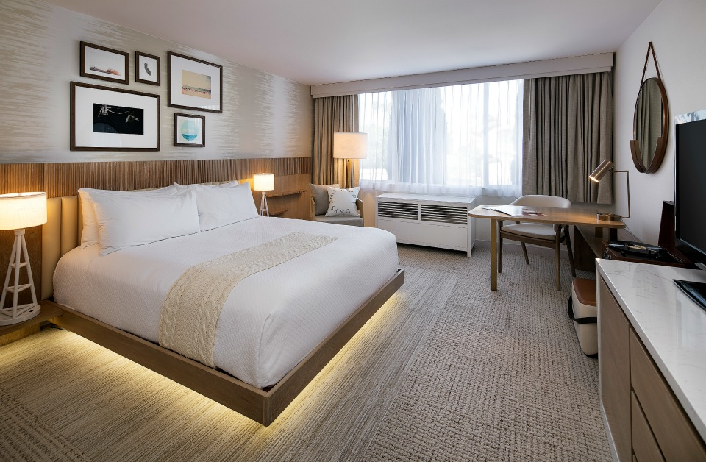

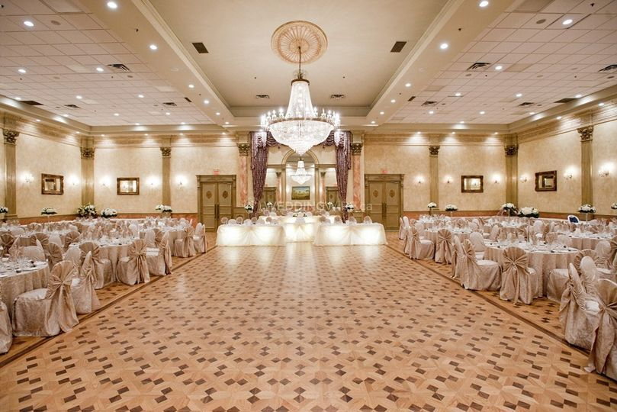
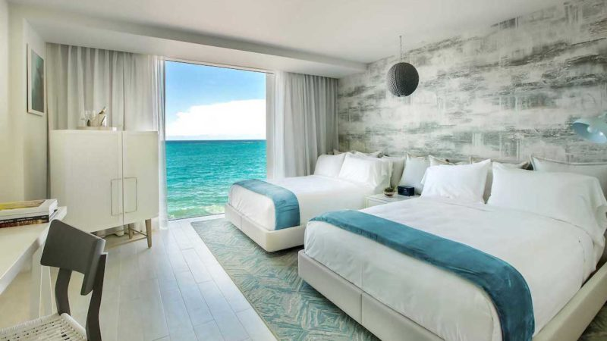


return
Note : To see more information click on the items.
Ahmed Ashraf
Rooms
Restaurant
Hall
Rooms in the Al-Bashir Hotel are two types:
1.Single rooms
2.Double rooms
A lot of foods and drinks in our restaurant and you and your family will enjoy a lot in our restaurant.
Hall in the Al-Bashir Hotel are four types:
1. Wedding hall
2. Birthday Hall
3. celebration hall
4. Consolation Hall
Swimming bool

Slide 6
return
Ahmed Ashraf
The number of rooms is 315 and 316
Booking :-
Child 1
name
Mahmoud Ashraf
Name
Ahmed Hassen
User name : mahmoud@bashir.com
Password :152025
Relation ship
Son
SSN
10905197
Phone
01111188260
Child 2
Birth date
2000 \ 3 \ 19
Name
Nora Ahmed
Check in date
2019 \ 10 \ 20
Relation ship
Wife
Check out date
2019 \ 20 \ 25
Child 3
Grade of room
Frist
The number of rooms
2
Name
Mariam Hassen
The number of child
3
Relation ship
daughter
Save

Slide 7
return
Ahmed Ashraf
Pay was successful
Bill :-
If you want to pay click here
name
Mahmoud Ashraf
SSN
10905197
Pay
Payment method
Master card
Bill
Password
*********
Room cost
200*5=1000 $
Pay
Restaurant cost
500 $
Gym cost
200 $
Hall cost
0 $
Total cost
=1700 $

Slide 8

return
Ahmed Ashraf
Information:-
Mahmoud Ashraf
manger
Mustafa Hussain
Programmer
Mohamed Essam
accountant
Ahmed Mousa
translator
Mustafa Ramadan
coach

Slide 9
return
Login was successful
Sign in
User name
mahmoud2000@bashir.com
Password
*********
Login

Slide 10





Manger
Receptionist
Restaurant
Hall
Programmer
Exit

Slide 11
Sign in
User name
manger@bashir.com
Password
*********
Login

Slide 12




mahmoud Ashraf
Al-Bashir Hotel
B
Employee`s info
Rooms
Room services
Restaurant
Revenue
Hall
Bill
return
Manger

Slide 13
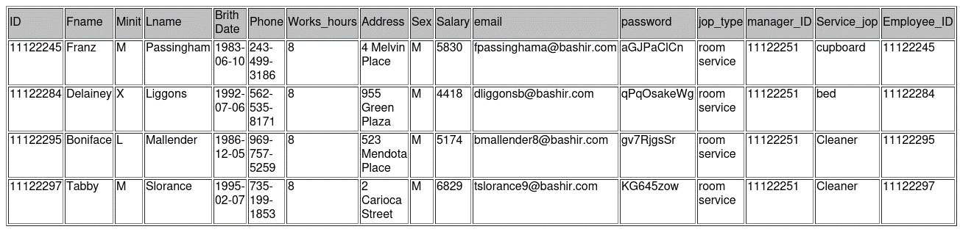
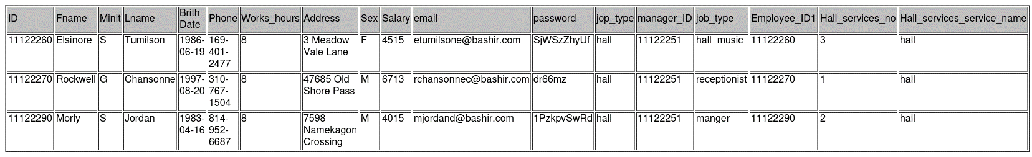
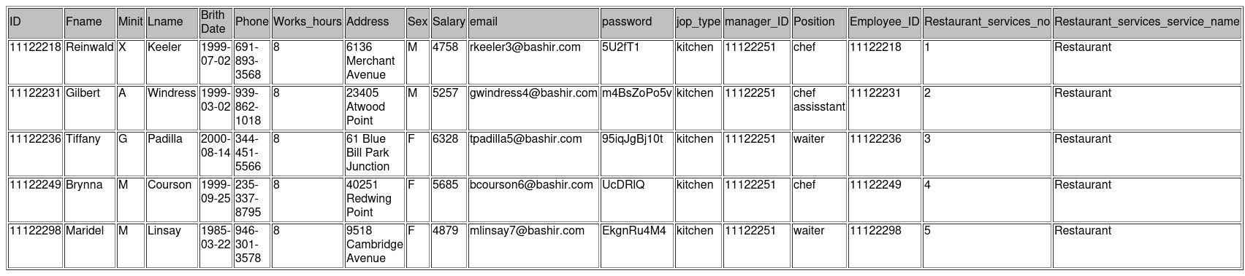
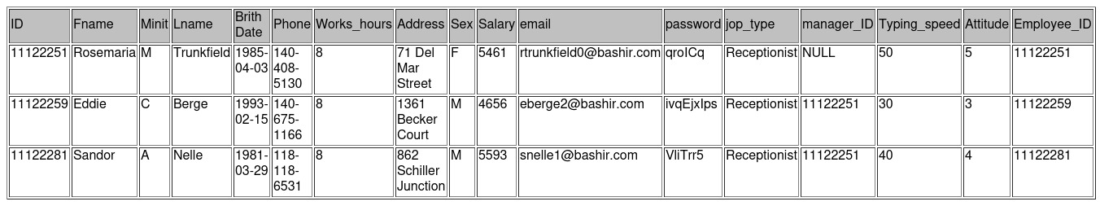
return
Receptionist
Kitchen worker
Hall worker
Service worker
mahmoud Ashraf
SELECT DISTINCT * from Employee e, room_service k WHERE e.ID=k.Employee_ID GROUP BY e.ID;
SELECT DISTINCT * from Employee e, hall_worker k WHERE e.ID=k.Employee_ID1 GROUP BY e.ID;
SELECT DISTINCT * from Employee e, kitchen_worker k WHERE e.ID=k.Employee_ID GROUP BY e.ID;
select * from Employee e, Receptionist r
where e.ID=r.Employee_ID ;

Slide 14
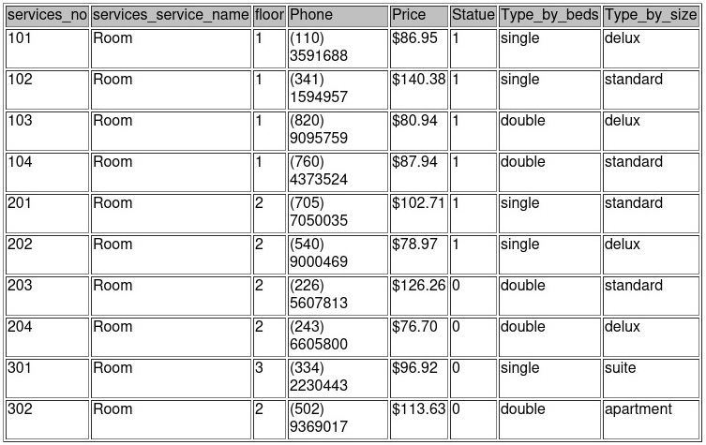
return
mahmoud Ashraf
SELECT * from room ;
Manger

Slide 15
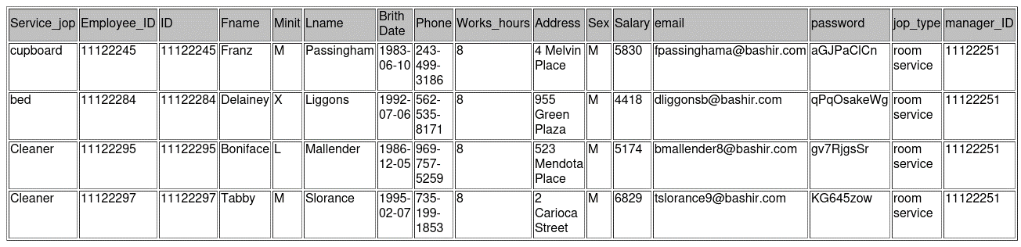
return
mahmoud Ashraf
SELECT * from room_service,employee where ID=Employee_ID;
Manger

Slide 16
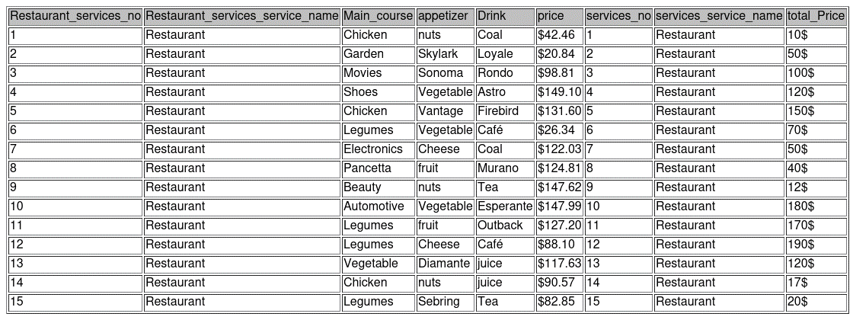
return
mahmoud Ashraf
select * from menu m,restaurant r where r.services_no=m.Restaurant_services_no and
r.services_service_name=m.Restaurant_services_service_name;
Manger

Slide 17
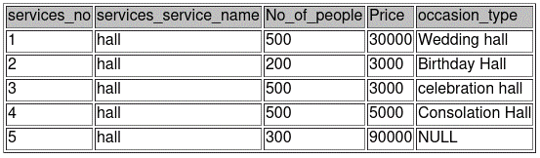
return
mahmoud Ashraf
select * from hall;
Manger

Slide 18

return
mahmoud Ashraf
Select sum(total_Price) AS Revenue from Bill;
Manger

Slide 19
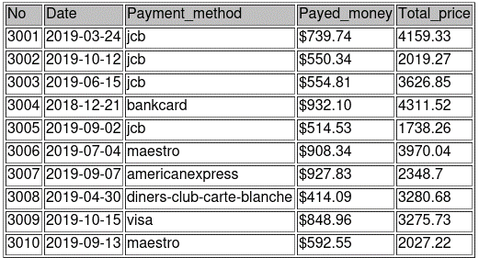
return
mahmoud Ashraf
Select * from Bill;
Manger

Slide 20
Sign in
User name
Receptionist@bashir.com
Password
*********
Login

Slide 21

mahmoud Ashraf
Al-Bashir Hotel
B
Al-Bashir Hotel
B
New Client
Empty rooms
Bill
return
Receptionist

Slide 22
return
mahmoud Ashraf
Al-Bashir Hotel
The number of rooms is 315 and 316
B
Booking :-
Child 1
name
Mahmoud Ashraf
Name
Ahmed Hassen
User name : mahmoud@bashir.com
Password :152025
Relation ship
Son
SSN
10905197
Phone
01111188260
Child 2
Birth date
2000 \ 3 \ 19
Name
Nora Ahmed
Check in date
2019 \ 10 \ 20
Relation ship
Wife
Check out date
2019 \ 20 \ 25
Child 3
Grade of room
Frist
The number of rooms
2
Name
Mariam Hassen
The number of child
3
Relation ship
daughter
Save
Receptionist

Slide 23
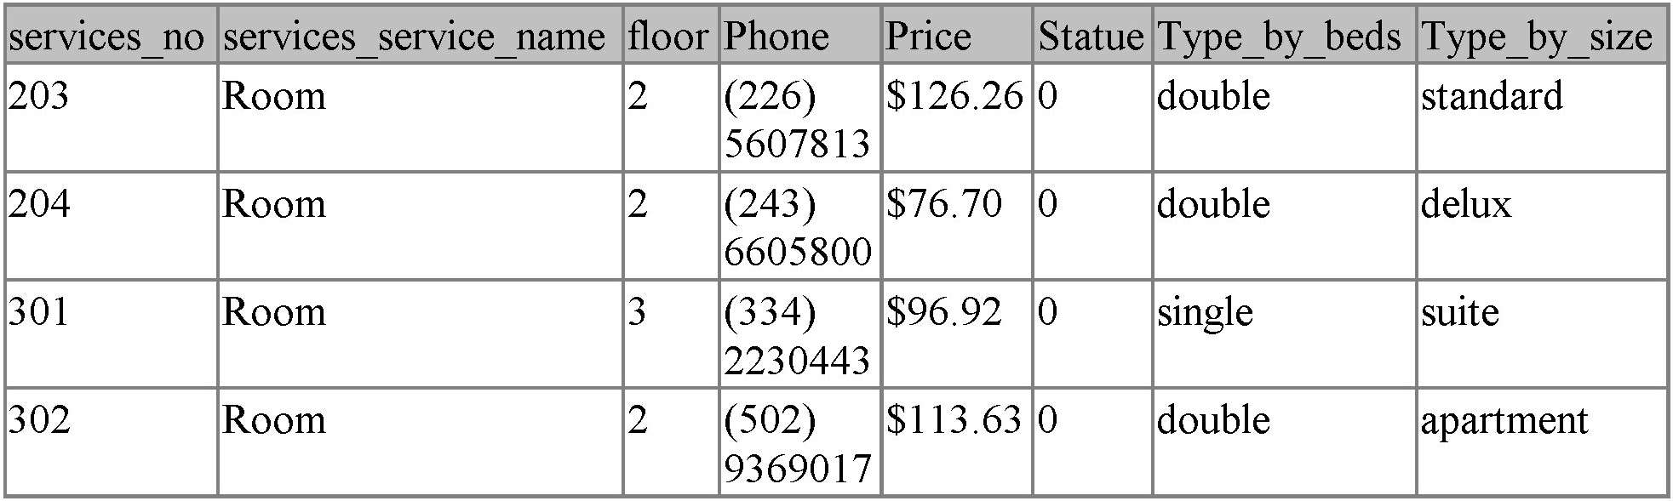
return
mahmoud Ashraf
Al-Bashir Hotel
B
SELECT * FROM
room WHERE statue=0;
Receptionist

Slide 24
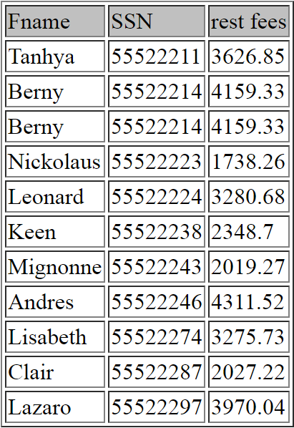
return
mahmoud Ashraf
Bill
Al-Bashir Hotel
B
select
c.Fname ,c.SSN ,(bi.Total_price-bi.Payed_money ) 'rest fees'
from client c join books b on c.SSN=b.Client_SSN join bill bi on b.Bill_No=bi.No;
Receptionist

Slide 25
Sign in :-
User name
Restaurant@bashir.com
Password
*********
Login

Slide 26

return
Restaurant :-
Employee info
name
Mahmoud Ashraf
SSN
10905197
Menu
Meal info
Meal name
Chicken
Price
10 $
Restaurant

Slide 27
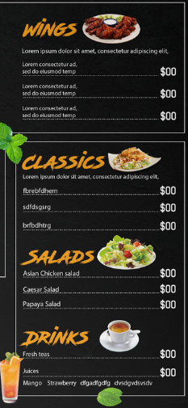
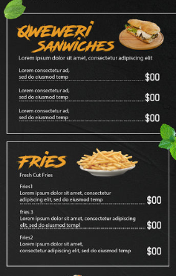



return
N Al-Bashir restaurant
B
6,st…
01111188260
Al-Bashir@gmail.com
Al-Bashir@gmail.com
Restaurant

Slide 28
Sign in :-
User name
Hall@bashir.com
Password
*********
Login

Slide 29

return
Hassen Ashraf
Booking was successful
Hall
Employee info
name
Mahmoud Ashraf
SSN
55522211
Hall info
Occasion type
Wedding hall
No of people
500
Price
30000 $
Save
Hall

Slide 30
Sign in :-
User name
Programmer@bashir.com
Password
*********
Login

Slide 31








mahmoud Ashraf
Al-Bashir Hotel
B
Objective
Database description
EER-Diagram
Rational schema
Quarries
Insert Data
PDF file
return
programmer

Slide 32
return
mahmoud Ashraf
Objective
We aim to record all data about our employee and client and services details to ensure quality.
The customer can book the rooms through online or through phone or by anther person.
Real time information of available rooms.
programmer

Slide 33
return
Database Descriptions
mahmoud Ashraf
Database Descriptions
1
Each client has many booking records, can booking many rooms, can booking many halls and may have several companions.
Each booking record can have only one rooms.
Each booking record may have only one several rooms or one several services.
Each client has one bill.
Employee has one manager.
Receptionist may insert many booking records.
Each room services serve many rooms.
Many kitchen workers work in one restaurant.
Many hall workers work in one hall.
We create a database about Hotel it is keeps track of a hotel’s employee, services, hall, restaurant and its menu, rooms, booking, bill, client and its companion.
The employee has ID as a primary key, phone no, hour of work, name as (first name, middle name and last name), birth date, salary, email, password.
employee is a superclass of a subclasses (Receptionist has "typing speed, attitude”, Room service has “serve type”, Kitchen worker has “position” and hall worker has “jobs”).
client has name as (first name, middle name and last name), address, phone no, ID as primary Key, birth day, email and password.
Companion has name, age, relationship.
the services have no as a primary key and service name as a primary key.
services is a superclass of a subclass (Room has" no, Flore no, Price, type of room which domain is" single, double", status as Boolean", hall has" no of people, price, occasion" and restaurant has "total price").
menu has drinks, main course, price, appetizer.
2
programmer

Slide 34
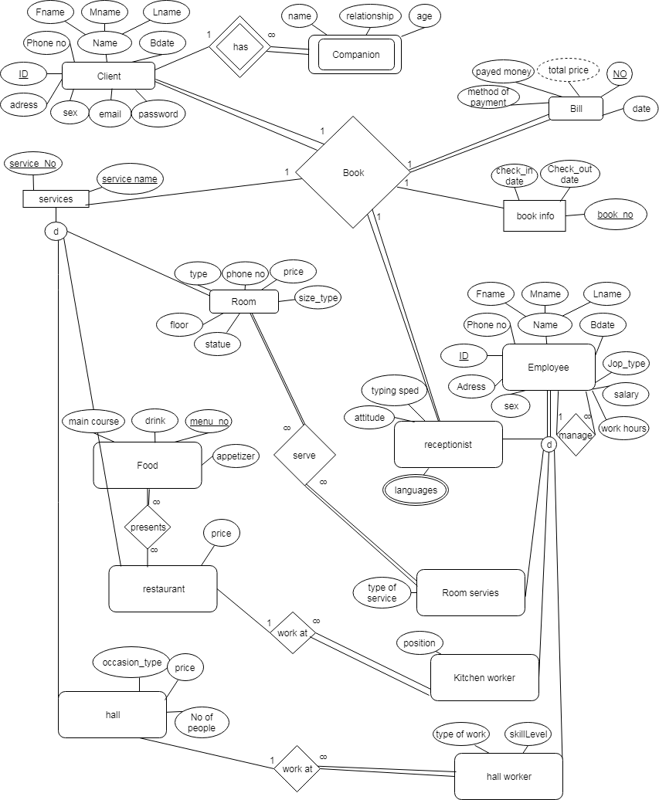
return
programmer

Slide 35
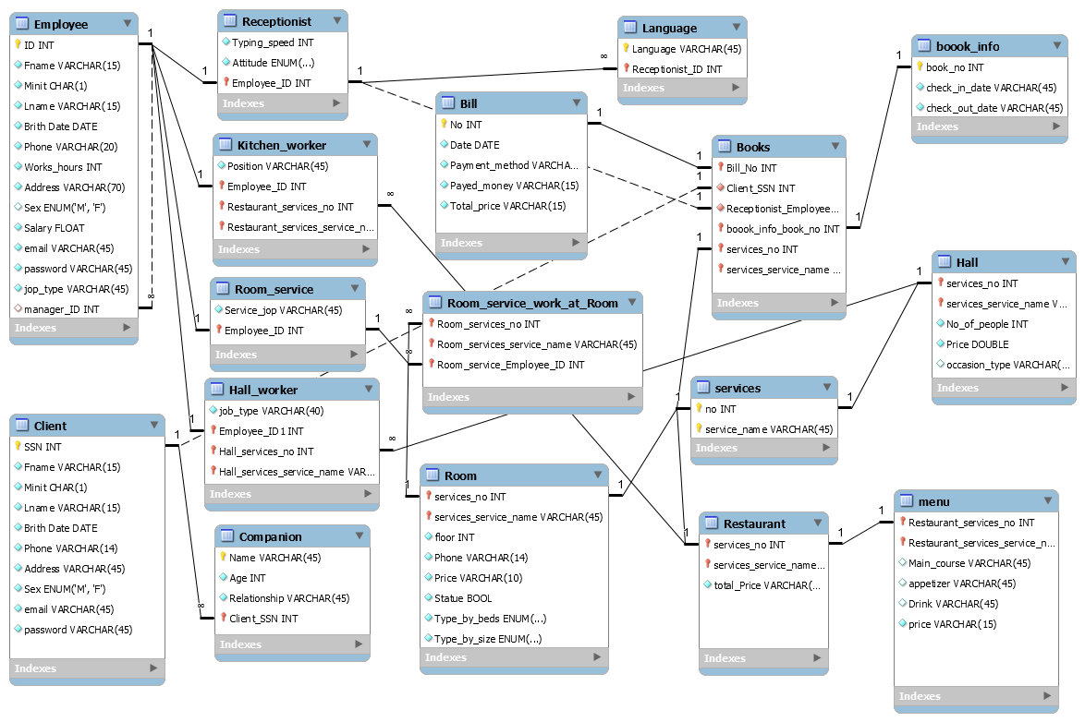
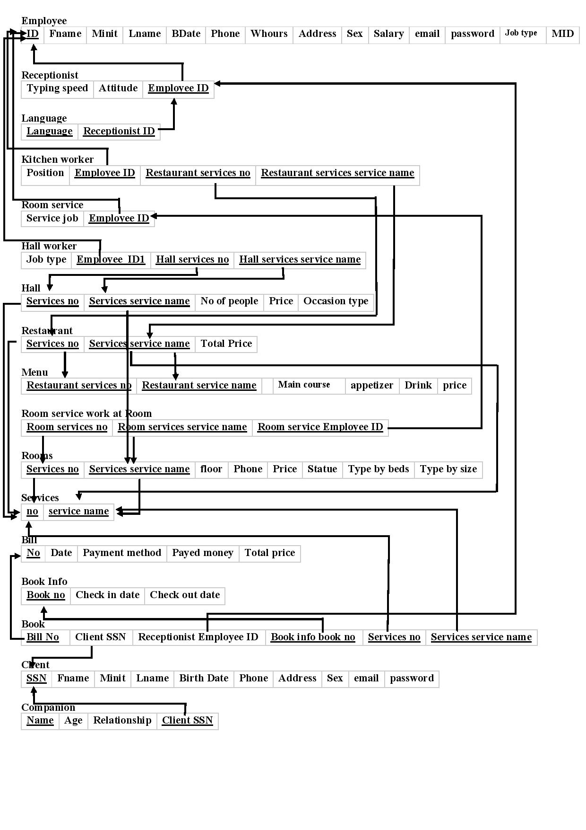
return
programmer

Slide 36
return
Queries
mahmoud Ashraf
retrieve all the client data.
retrieve the client full name and the data of his companions.
retrieve all basic data of our employee.
retrieve employee name that has no manager.
retrieve the number of employees in the hotel.
retrieve the employee that take the highest salary in our hotel.
retrieve the employee that take the minimum salary in our hotel .
using aggregation and nesting query retrieve the employee in room service that has salary more than the average.
retrieve the employee that work as Receptionist.
retrieve the employee that work as Room service.
retrieve the employee that work in Kitchen.
retrieve the employee that work in Hall.
retrieve all rooms data.
retrieve all the unbooked rooms data.
retrieve the man who is responsible for cleaning room number 101.
retrieve the client name and the room he has booked.
retrieve the name of the client and the date of rooms he booked.
retrieve the client name and the table he has booked.
retrieve the client name and the hall he has booked.
using grouping and some aggregation function retrieve clients name that booked more than one room and return the number of rooms he booked.
retrieve every client and all of things that he has booked.
retrieve the rest of money that the client should pay.
Other queries.
programmer

Slide 37
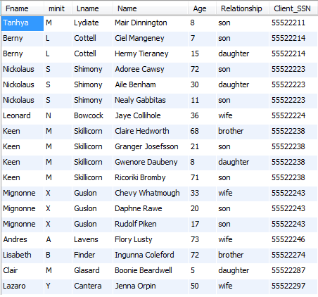
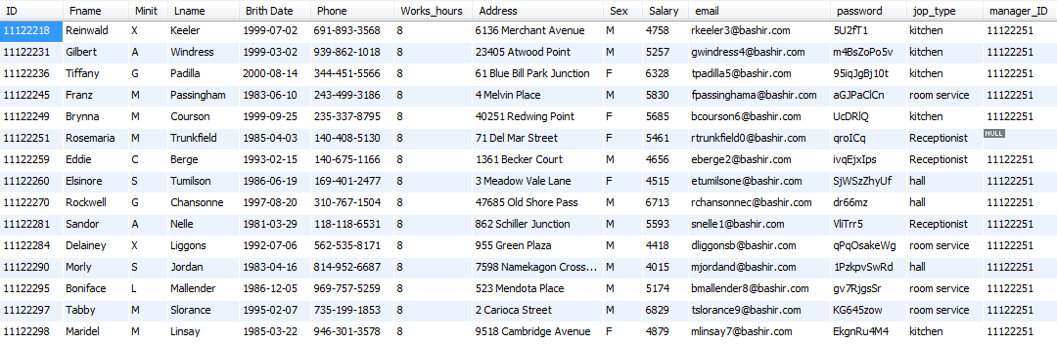
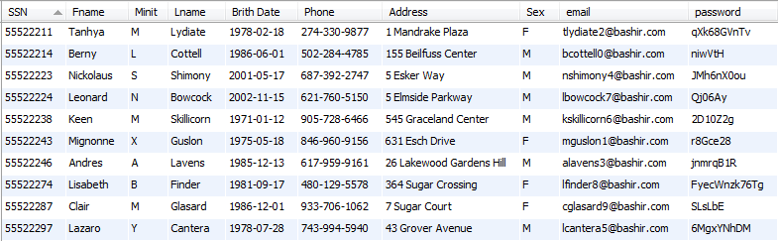
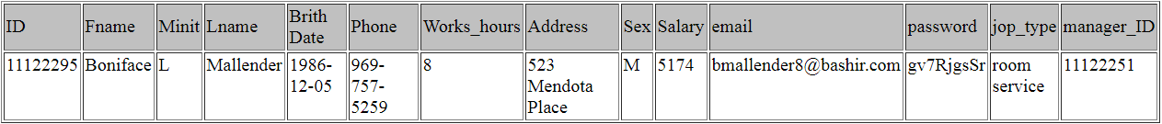
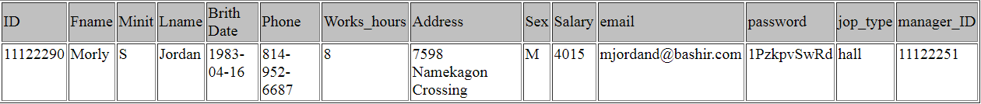
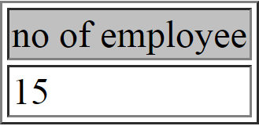
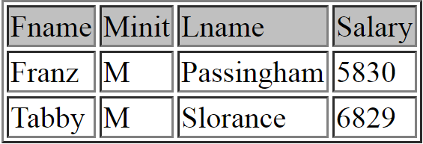
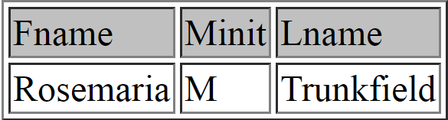
return
mahmoud Ashraf
retrieve the man who is responsible for cleaning room number 101.
retrieve the client full name and the data of his companions.
retrieve all basic data of our employee.
12
1
SELECT c.Fname, c.minit, c.Lname , cc.* FROM client c ,companion cc WHERE c.SSN=cc.Client_SSN;
select e.* from room_service rs ,room_service_work_at_room w ,Employee e WHERE w.Room_services_no=101 AND w.Room_service_Employee_ID=rs.Employee_ID AND rs.Employee_ID=e.ID;
SELECT c.Fname, c.minit, c.Lname , cc.* FROM client c ,companion cc WHERE c.SSN=cc.Client_SSN;
retrieve all the client data.
13
2
using aggregation and nesting query retrieve the employee in room service that
has salary more than the average.
retrieve the man who is responsible for cleaning room number 101.
retrieve the employee that take the minimum salary in our hotel .
retrieve the employee that take the highest salary in our hotel.
retrieve the number of employees in the hotel.
retrieve employee name that has no manager.
3
SELECT * FROM Client;
14
4
SELECT ee.Fname,ee.Minit,ee.Lname ,ee.Salary FROM Room_service rr,employee ee WHERE ee.ID=rr.Employee_ID AND salary >(SELECT AVG(e.Salary) from Room_service rs ,employee e where e.ID=rs.Employee_ID);
select e.* from room_service rs ,room_service_work_at_room w ,Employee e WHERE w.Room_services_no=101 AND w.Room_service_Employee_ID=rs.Employee_ID AND rs.Employee_ID=e.ID;
SELECT * FROM employee WHERE Salary=(select max(Salary) from employee);
SELECT Fname,Minit,Lname from employee where manager_ID is null;
15
SELECT count(*) as 'no of employee' from employee;
SELECT * FROM employee WHERE Salary=(select MIN(Salary) from employee);
5
+
6
7
8
9
10
11
programmer

Slide 38

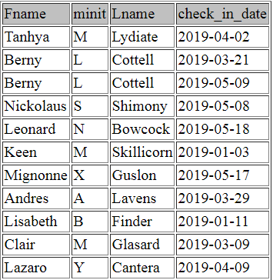
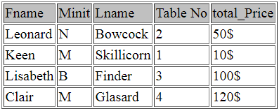
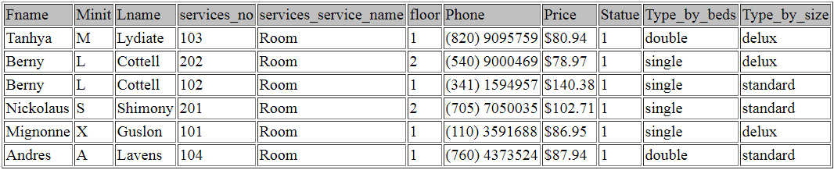
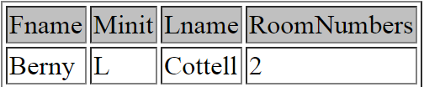

return
retrieve the rest of money that the client should pay .
using grouping and some aggregation function retrieve clients name that booked more than one room and return the number of rooms he booked.
retrieve the name of the client and the date of rooms he booked.
16
select c.Fname ,c.SSN ,(bi.Total_price-bi.Payed_money )
'rest fees’ from client c join books b
on c.SSN=b.Client_SSN
join bill bi on b.Bill_No=bi.No;
SELECT c.Fname, c.minit, c.Lname , bf.check_in_date FROM Client c , books b , boook_info bf WHERE c.SSN=b.Client_SSN AND b.boook_info_book_no=bf.book_no;
17
retrieve the client name and the hall he has booked.
SELECT c.Fname,c.Minit,c.Lname , count(r.services_no) AS RoomNumbers from Client c,books b,Room r WHERE c.SSN =b.Client_SSN AND b.services_service_name="room“ AND b.services_no= r.services_no group by c.SSN HAVING RoomNumbers>1 ORDER BY RoomNumbers DESC;
retrieve the client name and the table he has booked.
retrieve the client name and the room he has booked.
18
SELECT c.Fname,c.Minit,c.Lname, r.services_no AS "Table No" ,r.total_Pricefrom Client c, books b, Restaurant r WHERE c.SSN=b.Client_SSNANDb.services_service_name ="Restaurant“ AND b.services_no=r.services_no;
SELECT c.Fname,c.Minit,c.Lname, r.* from Client c, books b, Hall r WHERE c.SSN=b.Client_SSN AND b.services_service_name ="Hall“ AND b.services_no=r.services_no;
SELECT c.Fname,c.Minit,c.Lname, r.* from Client c, books b, Room r WHERE c.SSN=b.Client_SSN AND b.services_service_name ="Room“ AND b.services_no=r.services_no;
19
20
21
22
programmer

Slide 39
return
mahmoud Ashraf
To retrieve the number of employee in each job type
to retrieve the employee that work in Kitchen
SELECT jop_type , COUNT(ID) FROM employee
GROUP BY jop_type;
SELECT e.* ,count(ID) ' no of table he served',k.Position from Employee e, kitchen_worker k WHERE e.ID=k.Employee_ID group by Fname;
To retrieve number of rooms according to the number of beds
SELECT Type_by_beds , count(services_no) AS 'number of rooms' FROM room
GROUP BY Type_by_beds ;
to retrieve the employee that work in Hall as view
create view hall_worker as(select e.* ,count(ID)'number of hall he work in',h.job_type from Employee e, hall_worker h where e.ID=h.Employee_ID1 group by Fname);
To retrieve number of rooms according to the type of room
SELECT Type_by_size , count(services_no) AS 'number of rooms' FROM room
GROUP BY Type_by_size;
To retrieve the name of each client and the his bill details
select c.Fname ,c.SSN ,bi.*
from client c join books b on c.SSN=b.Client_SSN join bill bi on b.Bill_No=bi.No;
programmer

Slide 40
return
mahmoud Ashraf
retrieve every client and all of things that he has booked.
SELECT * FROM((SELECT c.SSN,c.Fname,c.Minit,c.Lname, r.* from Client c, books b, Room r WHERE c.SSN=b.Client_SSN AND b.services_service_name ="Room" AND b.services_no=r.services_no) t1 LEFT JOIN (SELECT c.SSN, c.Fname,c.Minit,c.Lname, r.services_no AS "Table No" ,r.total_Price from Client c, books b, Restaurant r WHERE c.SSN=b.Client_SSN AND b.services_service_name ="Restaurant"ANDb.services_no=r.services_no) t2 ON t1.SSN=t2.SSN) LEFT JOIN (SELECT c.SSN,c.Fname,c.Minit,c.Lname, r.* from Client c, books b, Hall r WHERE c.SSN=b.Client_SSNANDb.services_service_name ="Hall“ AND b.services_no=r.services_no) tt2 ON t2.SSN=tt2.SSN;
programmer

